Slide 1
ENDZONE PLAYBOOK
LCS ULTIMATE 2026

Slide 2
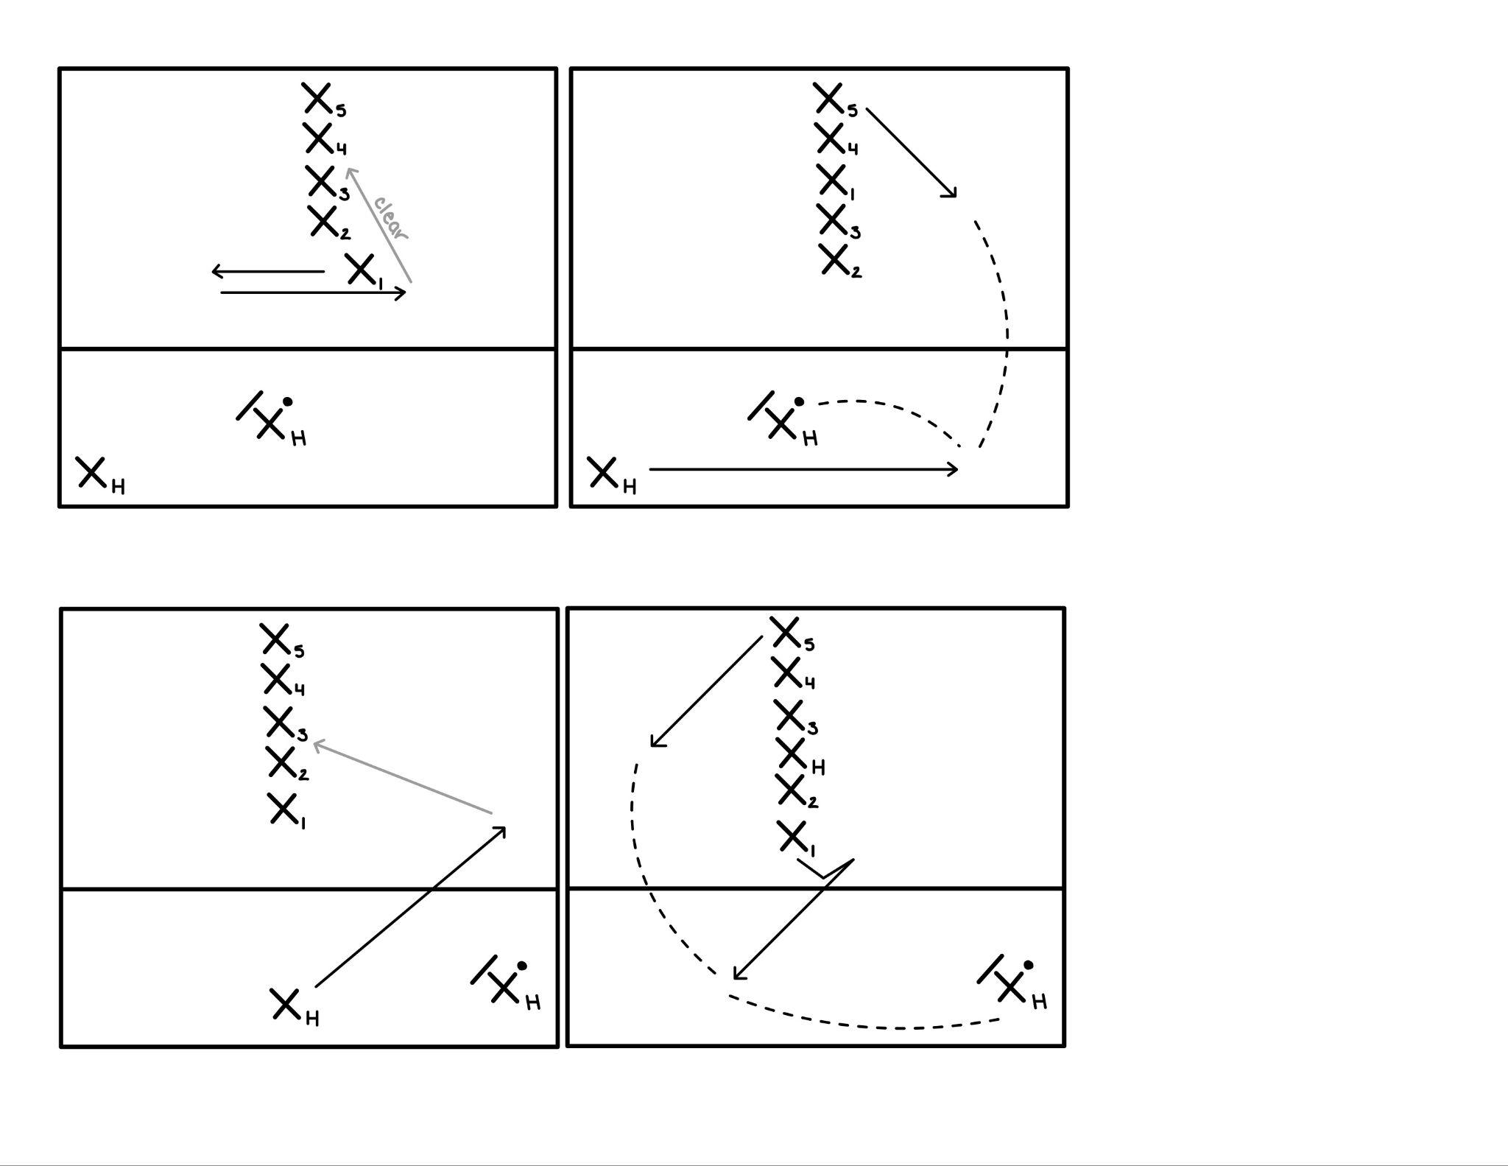
Disc In The Middle
Disc is in the middle with the handler, outside of the endzone
Reset handler out of stack, on break side of handler with the disc
5 cutters in a vertical stack in the middle of the endzone, front of stack offset
First 1-2 stalls, X1 cuts in isolation at front of the stack, if you don’t get open, clear to position 3
Reset handler cuts a jam cut and receives disc on the open side, back of stack cuts toward front corner of the endzone for the continuation to score

Slide 3
Disc On The Sideline
Disc on the sideline with the handler, outside of the endzone
Reset handler out of stack, on break side of handler with the disc
5 cutters in a vertical stack in the middle of the endzone
Reset handler cuts a burkley at -1 stall, if no throw goes up, clear to position 3 in stack
As handler is clearing, top of stack cuts a T-cut to the back of the field, receiving the disc on the breakside
Back of the stack cuts under to receive the continuation

Slide 4
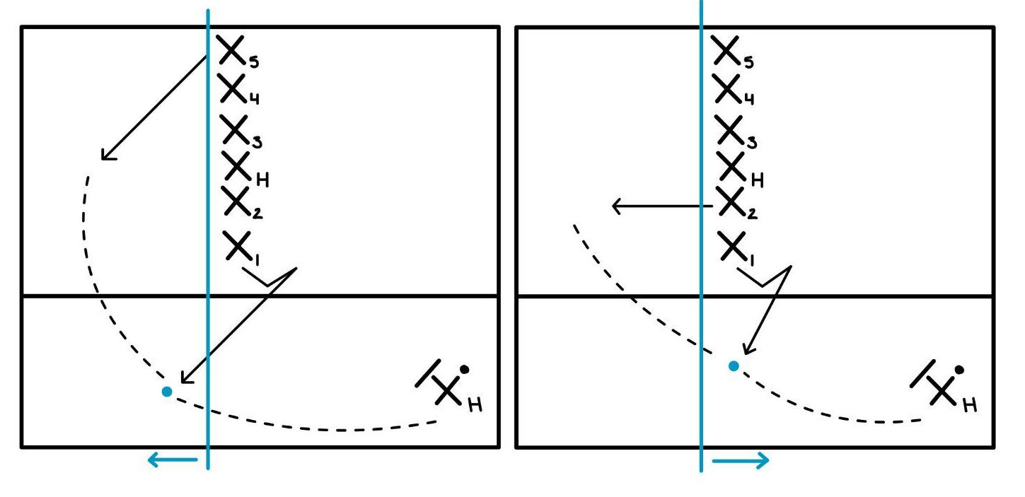
Continuation of Sideline Endzone
When the disc is thrown from the sideline to the reset running the T-cut…
If the disc is caught passed the stack, back of the stack is the continuation
If the disc is caught in-line or before the stack, top of the stack is the continuation

